Slide 1

Open Source Animation
- IIT Bombay
Porting from Flash to HTML5 Animations

Slide 2
About HTML5
HTML5 is a new web technology with several useful development elements.
With HTML5 you can develop animations, games, graphs online. Websites developed in HTML5 do not require Adobe Flash support anymore.
Most professional solutions are now being developed in HTML5 & CSS3.

Slide 3
Motivation for conversion of Flash animations to HTML5:
FOSS is defined as software whose source code of which is available to all users.
FOSS stands for Free and Open Source Software.
FOSS refers to the freedom to copy and re-use the software, rather than to the price of the software.
The HTML5 animations are being developed to serve as an open-source alternative for proprietary animation softwares like Adobe Flash.

Slide 4
Features
Language support for Development: HTML5, CSS3, Javascript
Tools used: Google Web Designer
Output file: HTML file
Develop the animations in HTML5.
All new versions of browsers support HTML5 like IE, Chrome etc.

Slide 5
Comparison between Flash and
HTML5
Flash | HTML5
Requires the plugin to run the animations. | It does not require any plugin to run the anmations.
It is not open source so anybody cannot modify the animations. | It is open source so anybody can modify the animations.
It has issues while running on mobile devices. | It is mobile device friendly. Runs perfectly on mobile devices.

Slide 6
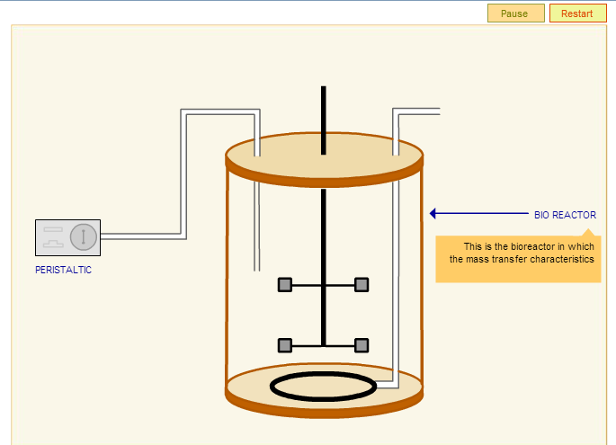
Flash Animation:

Slide 7
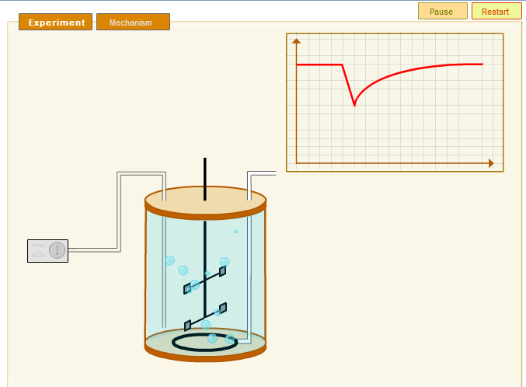
Flash based Working Animation

Slide 8
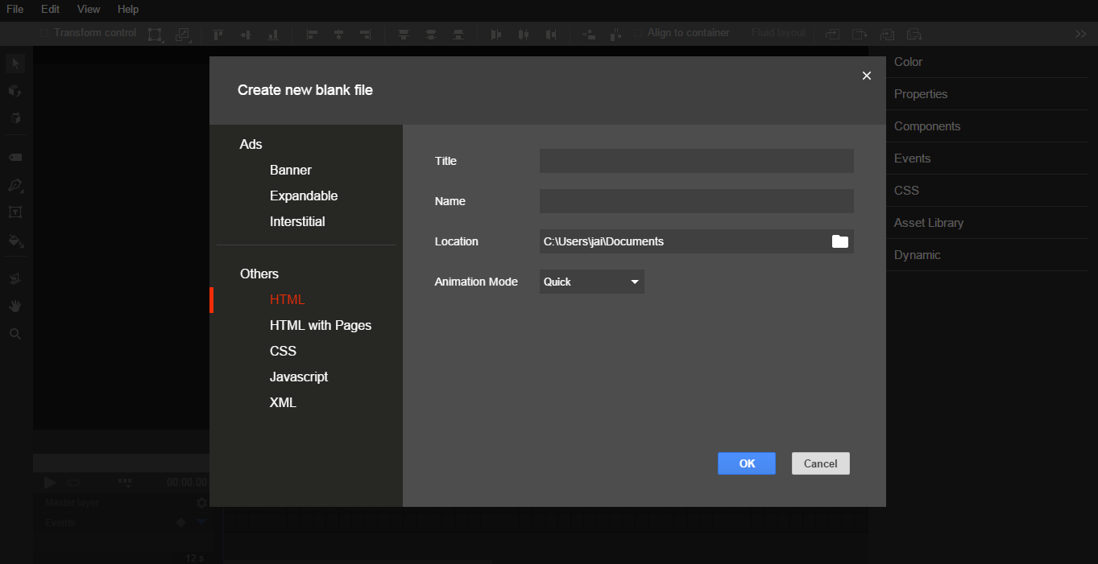
Animation using Google Web Designer
Choose to open and name the new HTML file.

Slide 9
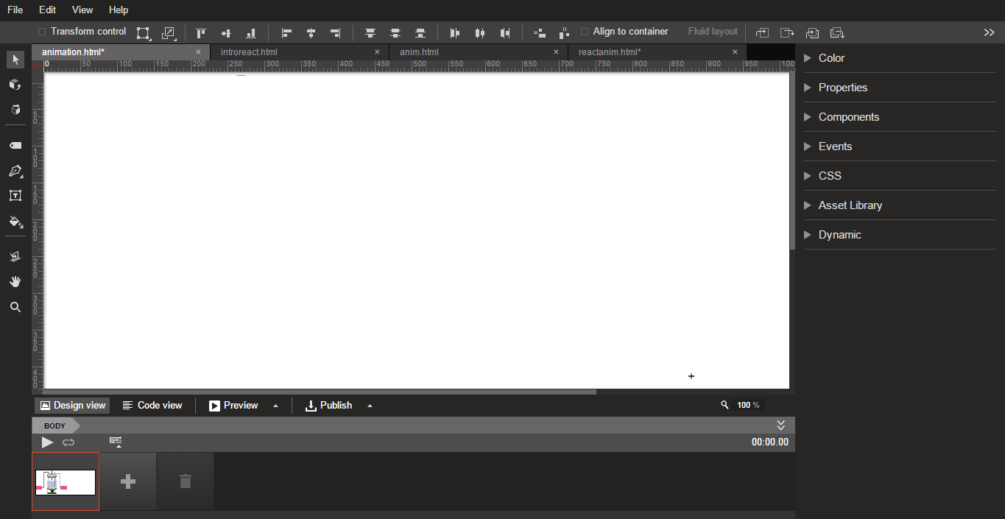
GWD Interface

Slide 10
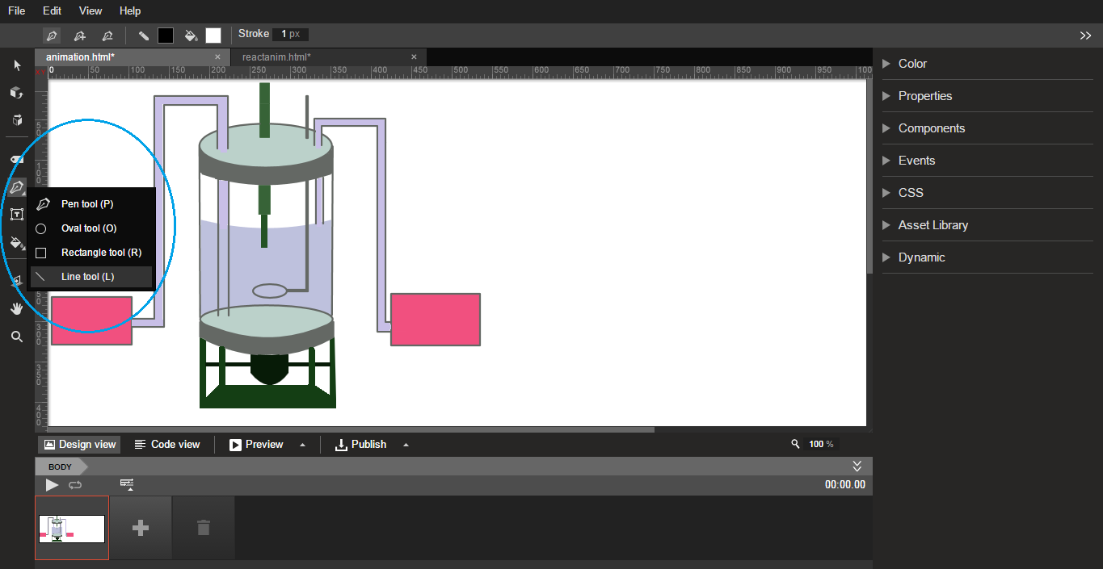
GWD Drawing Tools
Objects can be created using various tools.

Slide 11
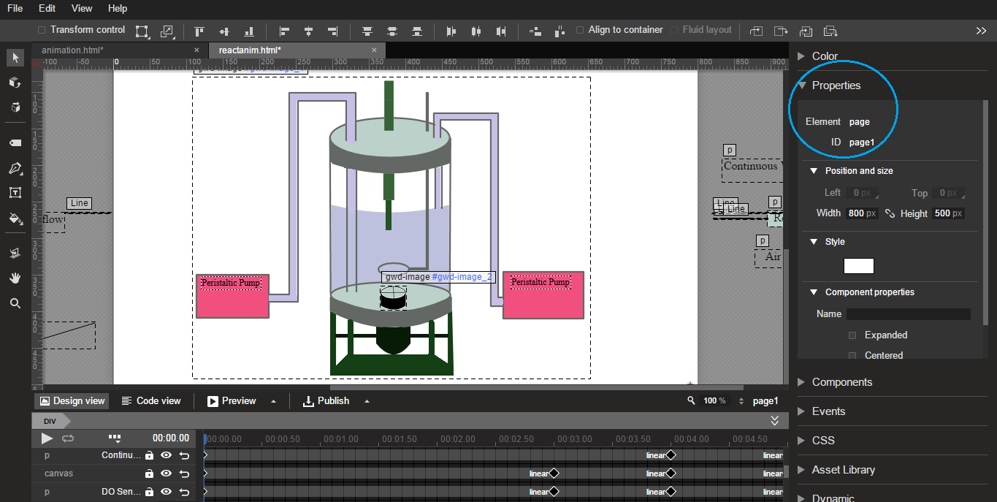
GWD Properties
You can set different properties in the properties panel.

Slide 12
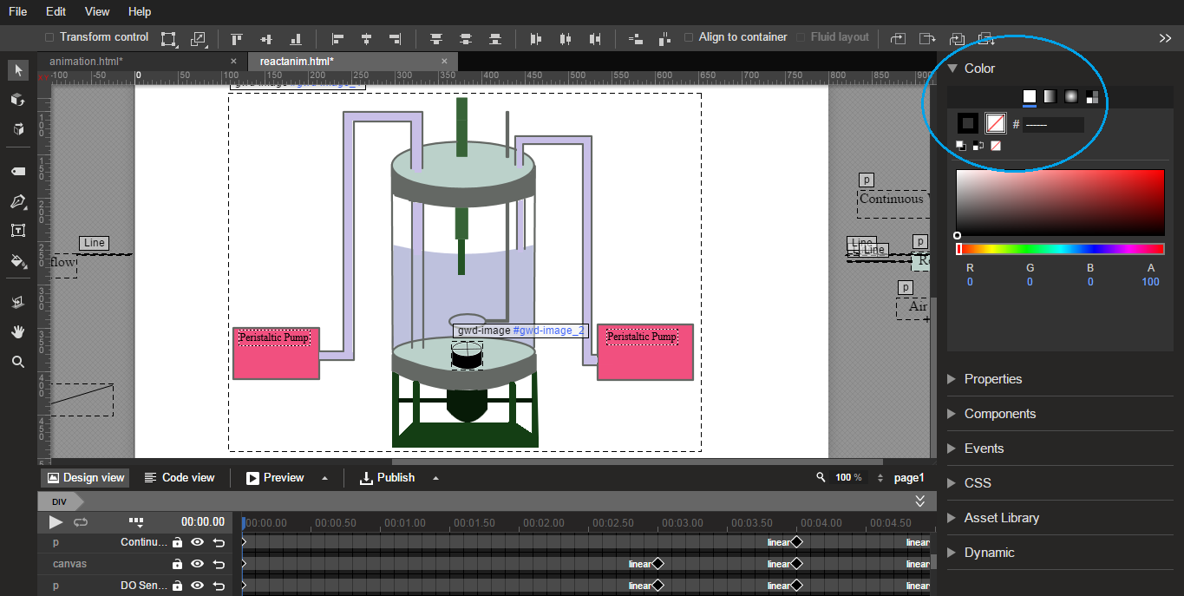
GWD Properties
You can set color properties in the color properties panel.

Slide 13
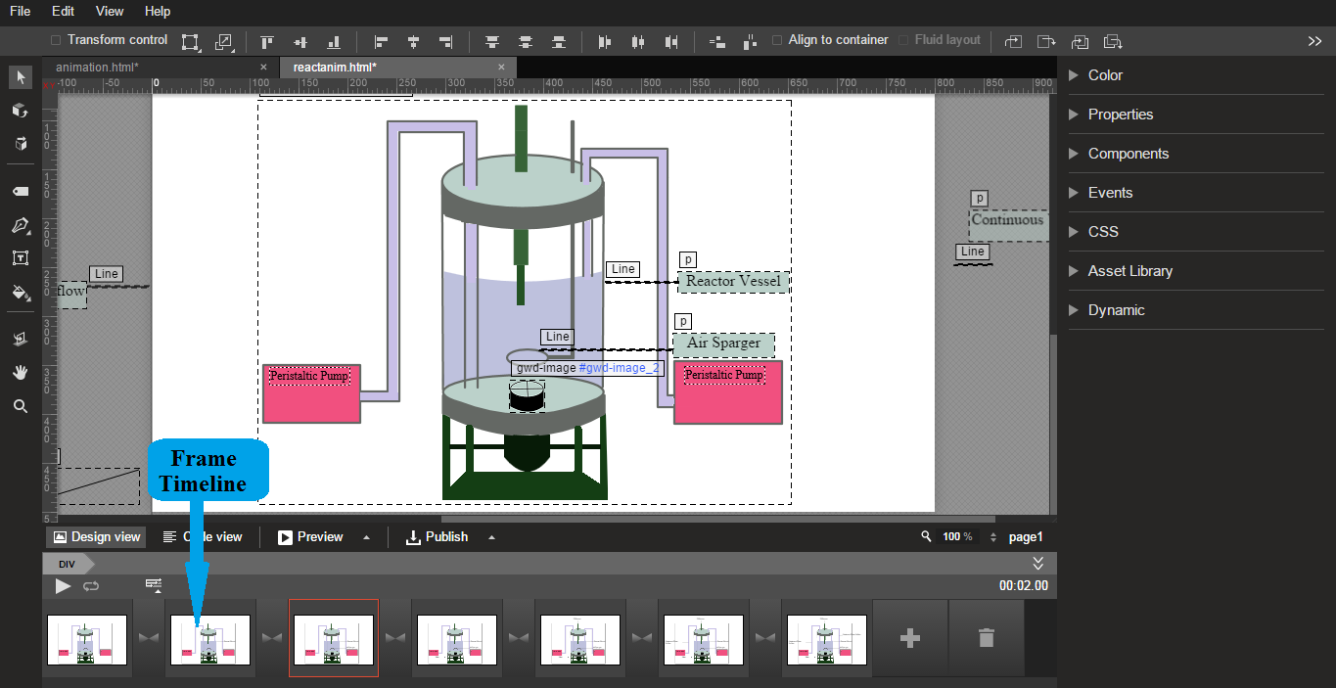
GWD Timeline
You can create animations frame by frame using frame timeline.

Slide 14
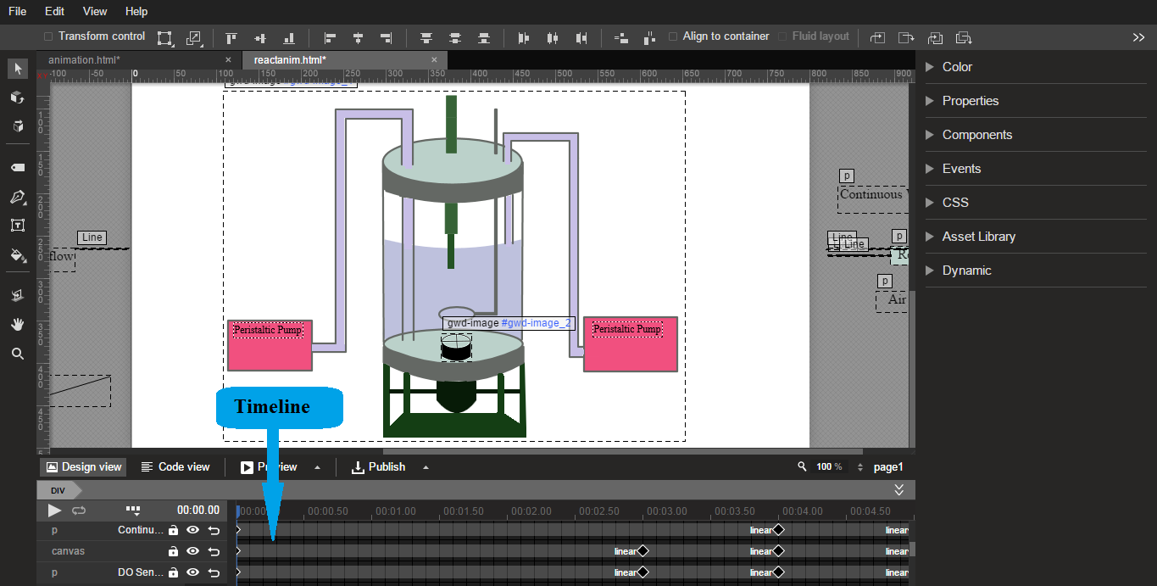
GWD Timeline

Slide 15
When you design the animation, it automatically generates the html code.
You can view the code in “View Code” window.

Slide 16
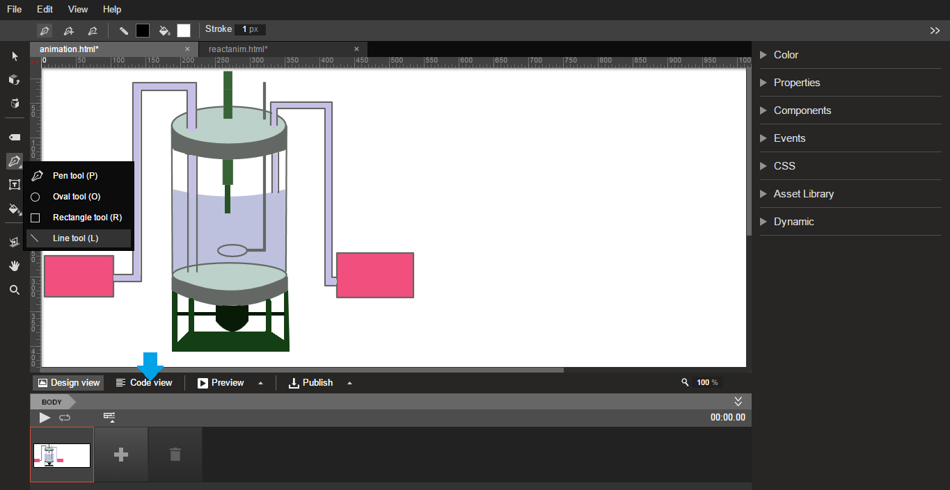

Slide 17
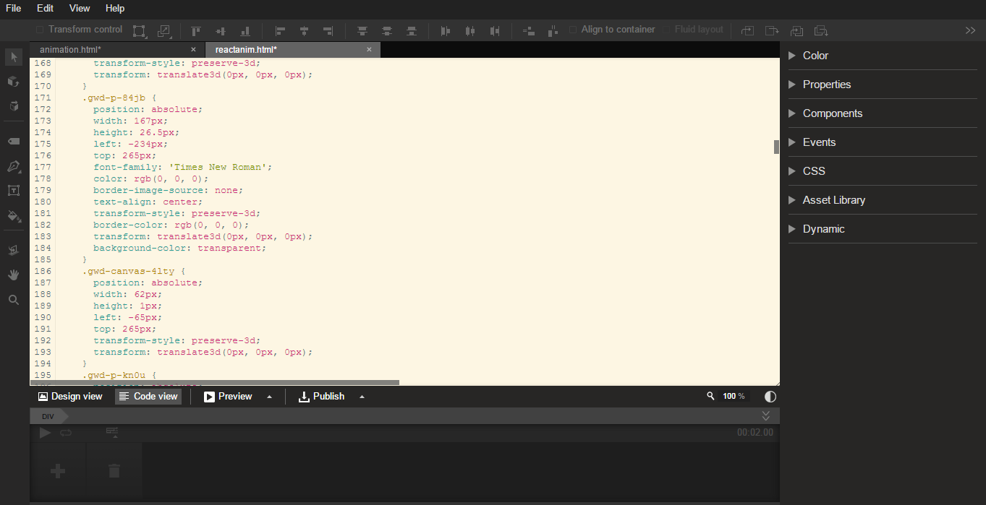
Code View

Slide 18
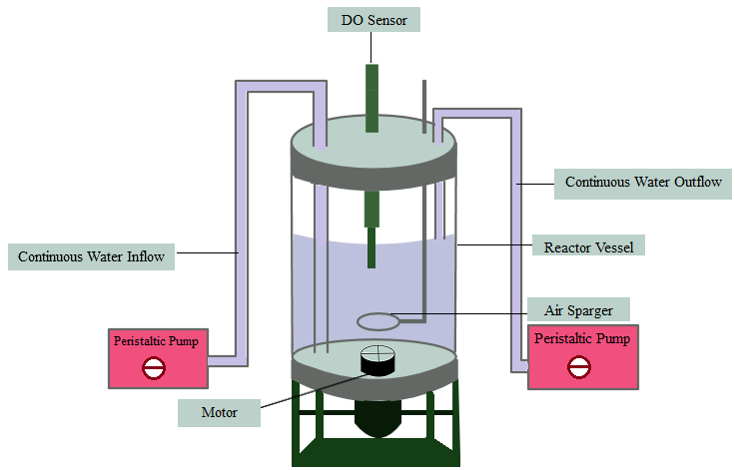
HTML5 Animation

Slide 19
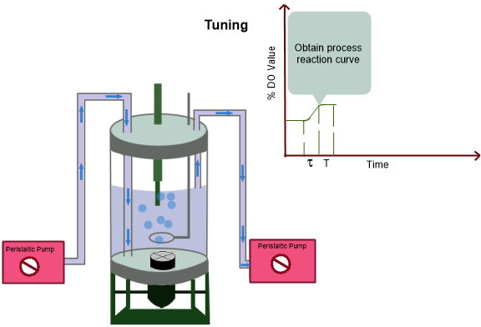
HTML5 Working Animation

Slide 20
Animations can also be created by writing the code in HTML5, CSS and javascript.

Slide 21
Website URL
vlabs.iitb.ac.in/rtlabs/

